Slide 1
UAV Route Planning Strategies for Efficient Coverage Search in Complex Environments
Gabriel Rovesti
Exam of 19th September 2024
Prof. Claudio Enrico Palazzi
Wireless Networks for Mobile Applications (WNMA)
2023-2024

Slide 2
Table of contents
Introduction
Overview of approaches
Classical approaches
Probabilistic methods
Nature-inspired algorithms
Multi-UAV coordination
Environment-specific approaches
Military applications
Military applications
Comparison of approaches
Future challenges and research directions

Slide 3
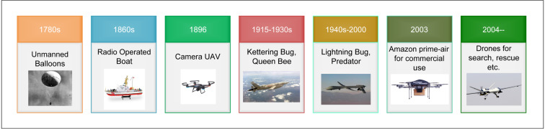
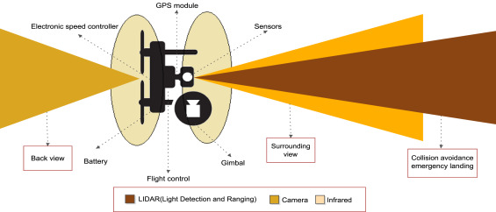
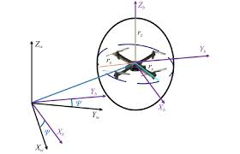
UAV Route Planning
Reference: https://www.sciencedirect.com/science/article/pii/S0140366419308539

Slide 4
Overview of approaches
Classical algorithms
Probabilistic methods
Nature-inspired algorithms
Multi-UAV coordination
Environment-specific approaches
Military applications

Slide 5
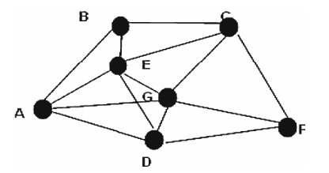
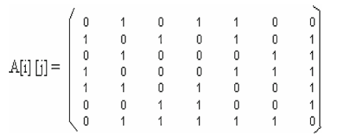
Classical approaches
Dijkstra’s Algorithm
A* Algorithm
Bellman-Ford Algorithm
Floyd-Warshall Algorithm
Reference: Multiple UAVs path planning algorithms: a comparative study (Paper 1)

Slide 6
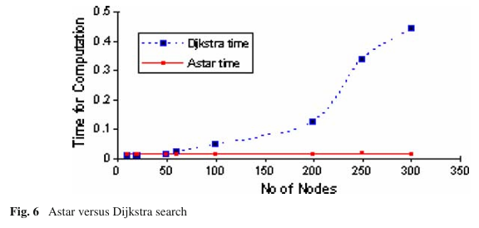
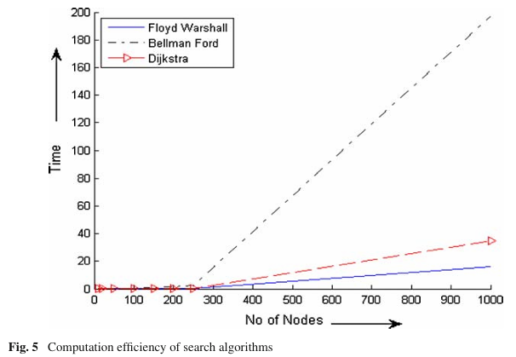
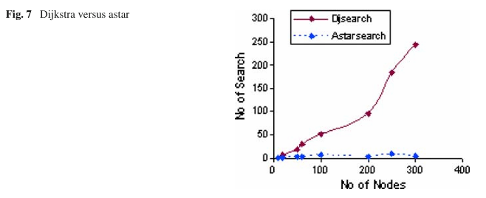
Classical approaches
Reference: Multiple UAVs path planning algorithms: a comparative study (Paper 1)

Slide 7
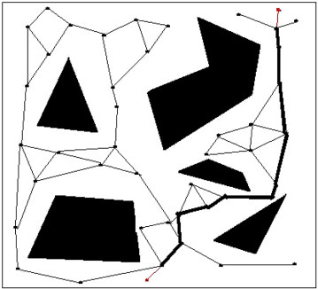
Probabilistic methods
Probabilistic Roadmap Method (PRM)
Efficient for high-dimensional configuration spaces
Two phases: learning phase and query phase
Handles complex 3D environments effectively
Key features
Random sampling of configuration space
Creation of roadmap for path planning
Efficient for large/complex environments
Reference: https://www.sciencedirect.com/science/article/pii/S0140366419308539

Slide 8
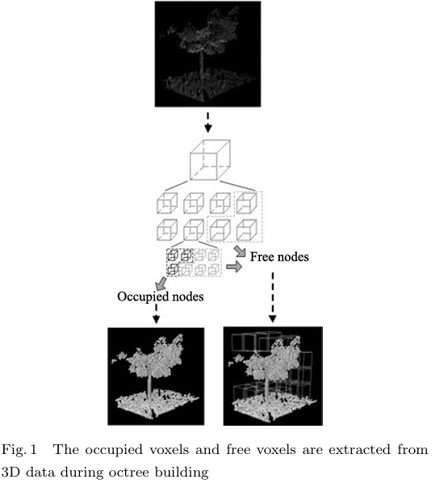
Probabilistic methods
Enhancements for UAV Applications
Octree-based environment representation
Safety-aware sampling
Bounding box array for focused sampling
Connectivity evaluation for feasible paths
Advantages
Handling obstacle avoidance well
Computationally efficient for large environments
Adaptable to different types of environments
Reference: Path Planning in Complex 3D Environments Using a Probabilistic Roadmap Method – (Paper 2)

Slide 9
Nature-inspired algorithms
Grey Wolf Optimization (GWO)
Inspired by social hierarchy and hunting behavior or grey wolves
Balances exploration and exploitation effectively
Particle Swarm Optimization (PSO)
Efficient for continuous optimization problems
Well-suited for dynamic UAV path plannig
Based on social behavior of bird flocking/fish schooling
Ant Colony Optimization (ACO)
Effective for discrete optimization and adaptive path planning
Mimics foraging behavior of ant colonies

Slide 10
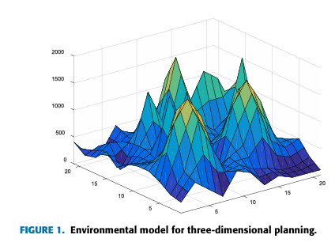
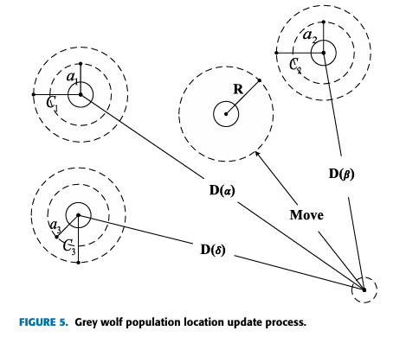
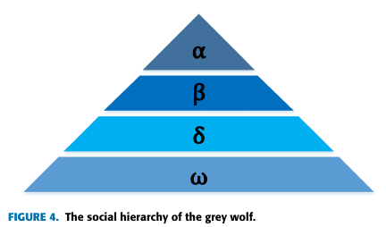
Nature-inspired algorithms
Reference: Path Planning of UAV Based on Improved Adaptive Grey Wolf Optimization Algorithm – (Paper 4)

Slide 11
Multi-UAV coordination
Extended from single-agent to multi-agent planning
Multiple Traveling Salesman Problem (MTSP)
Vehicle Routing Problem (VRP)
Key challenges
Grouping and task allocation among UAVs
Multi-objective optimization (e.g. distance, energy, risk)
Dynamic environments (e.g., synchronization precedence)
Solution methods
Meta-heuristic algorithms
Neural Networks (NN) for complex pattern learning
Hybrid approaches combining multiple algorithms

Slide 12
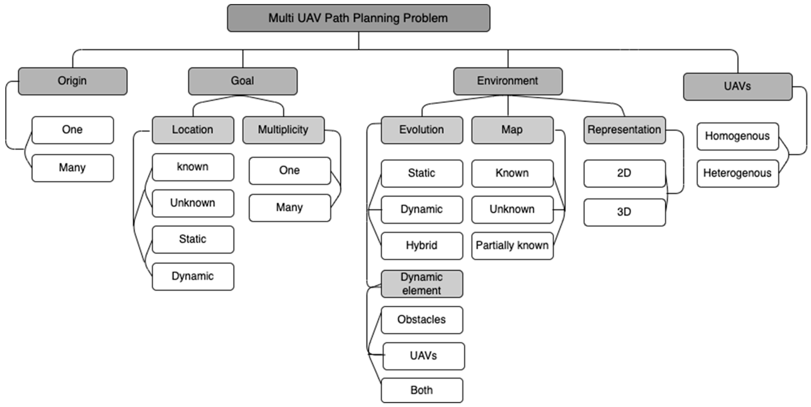
Multi-UAV coordination
Reference: https://www.mdpi.com/2227-7390/11/10/2356

Slide 13
Environment-specific approaches
Focus
River search scenarios (Yao et al.)
Key components
Gaussian Mixture Model (GMM) for probability distribution
Identifies high-value river segments and adjusts greedily
Approximation Insertion (AI) method for prioritization
Constructs search route iteratively
Innovative aspects
Uses prior information to estimate target locations
Adapts to river geometry and probability distributions
Balances detection probability and travel time

Slide 14
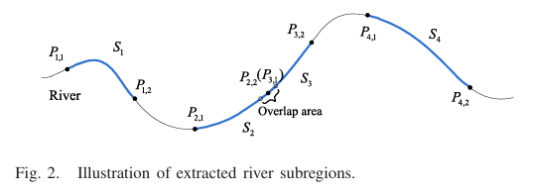
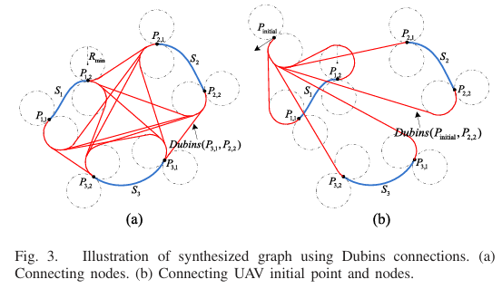
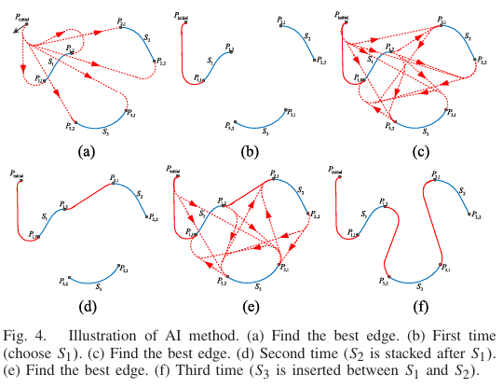
Environment-specific approaches
Reference: Optimal UAV Route Planning for Coverage Search of Stationary Target in River – (Paper 5)

Slide 15
Military applications
Unique challenges
Hostile environments with rapid changes
Multiple objectives and stringent constraints
Need for real-time planning and decision-making
Key approaches
Constrained Shortest-Path (CSP) method (Royset et al.)
Minimizes risk while satisfying fuel and time constraints
Uses Lagrangian Relaxation and Enumeration (LRE) algorithm
Real-time network approach (Myers et al.)
Incorporates obstacles and flight dynamics
Uses pseudonodes for realistic aircraft behavior
Adapts Djikstra’s algorithm for optimal paths

Slide 16
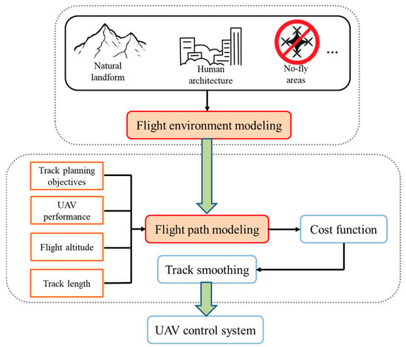
Military applications
Comparative strengths
CSP method: handles multiple constraints, suitable for complex missions
Real-time approach: fast computation, adaptable to dynamic environments
Limitations
Both focus on single-UAV routing
Limited handling of rapidly changing threat landscapes
Lack of multi-UAV coordination considerations
Reference: https://www.mdpi.com/2075-1680/12/7/702

Slide 17
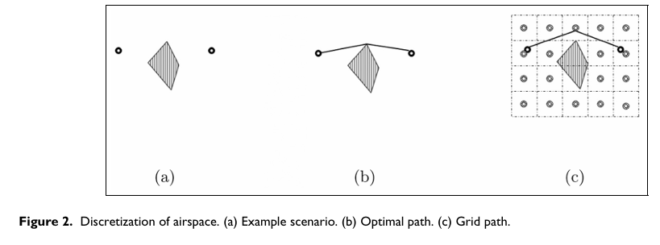
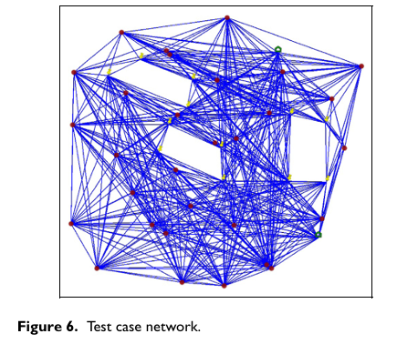
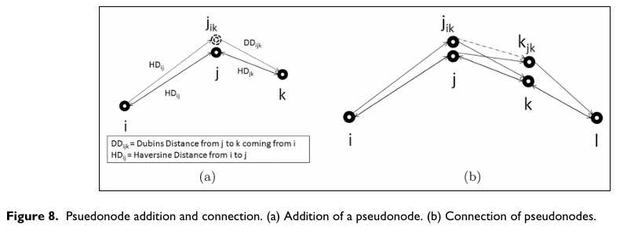
Military applications
Reference: https://www.acsu.buffalo.edu/~batta/myers.pdf

Slide 18
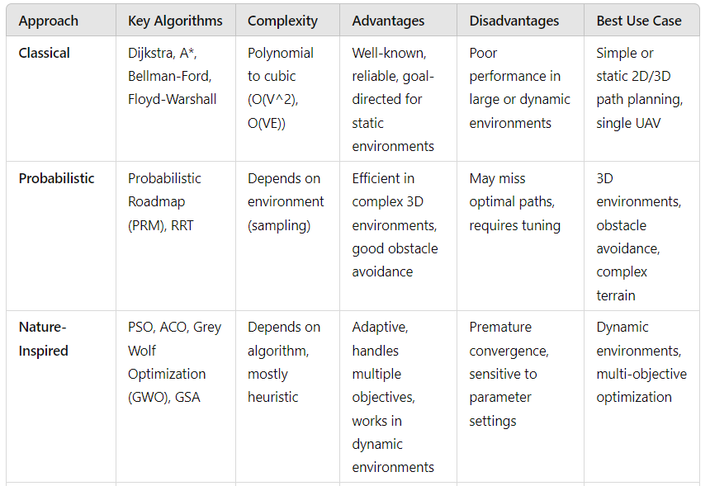
Comparison of approaches (1)

Slide 19
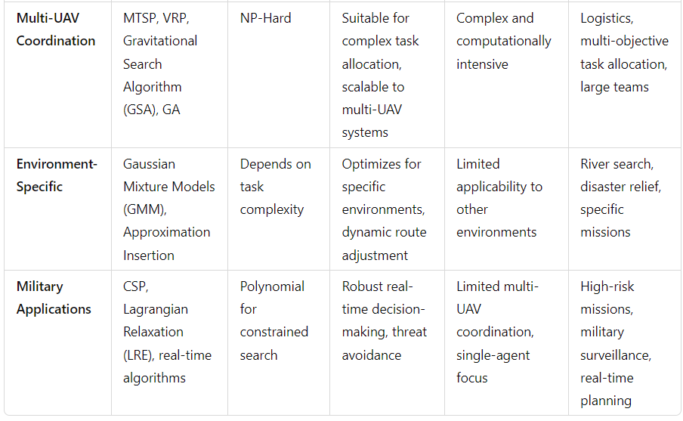
Comparison of approaches (2)

Slide 20
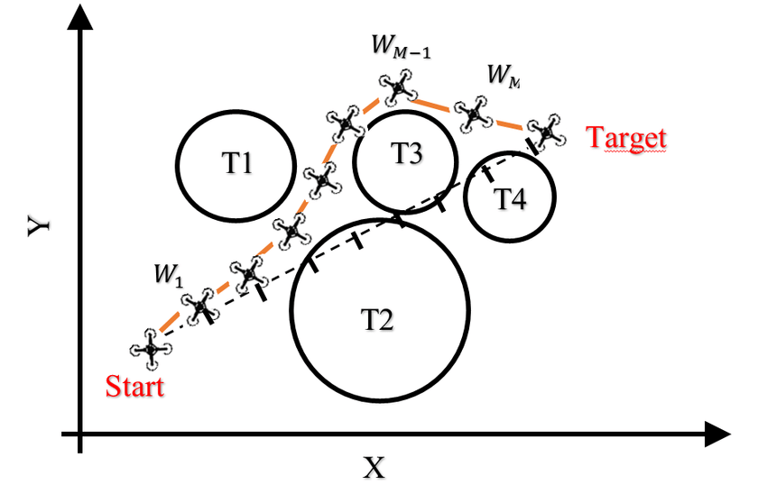
Future challenges and research directions
Integration with emerging technologies (e.g., 5G, IoT)
Scalability improvements and real-time adaptability
Multi-UAV coordination
Human-swarm interaction
Environmental considerations
Ethical and regulatory challenges (e.g., AI, robotics)
Reference: https://www.researchgate.net/figure/UAV-path-planning-model-in-2D-space_fig1_329311458

